Slide 1
Word World
By:
K. Anirudh(1602-20-737-124)
S. Manmateja(1602-20-737-145)
A. Nithin(1602-20-737-148)

Slide 2
ABSTRACT
The main aim of the project is to write a python script which produces platform where the user can test his/her technical skills by playing this game. This can be played by anyone who has basic technical knowledge and this can also be their stress buster, this game actually consists of three levels (easy, medium, hard), user should select a level to play the game, depending on the user’s choice the level of questions would be varied, as a part of this game a picture will be displayed and the user have to guess the required word which is asked in that image or the image would be related to that word and the user have to enter that word, user can also enter his answer in the form of voice through the voice option available in the window. If the entered word is correct then 10 points will be added to the player’s score else no points would be awarded.

Slide 3
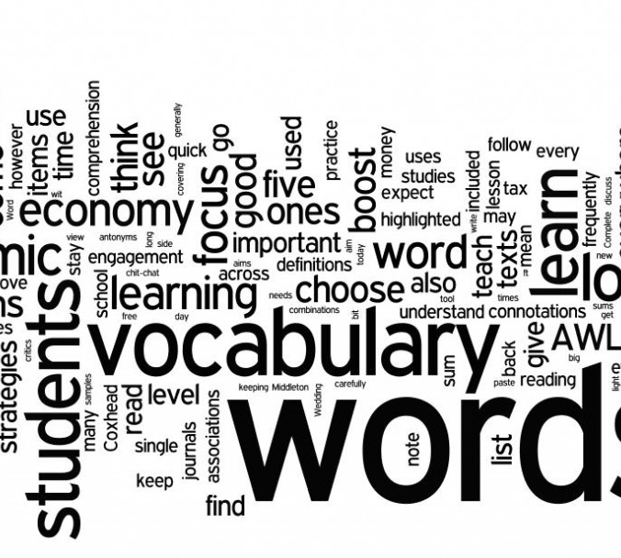
Features
User Friendly environment (easy to use)
Enhances logical and critical thinking
You can learn by playing
Can be played to reduce stress
Voice option is available

Slide 4

What is unique in this project?
In most of the preexisting ideas the hints of the words are provided early but in this one hints are not released earlier to promote logical thinking of the user
Voice option is available for user to give his response through voice.

Slide 5
Future scope
This idea can be further improved by implementing it with an application for various OS and it will be helpful especially for children to learn something in an innovative and effective way
This can be extended for online multiplayer by using Sockets/Networking and Pygame
Can be implemented as spell checker

Slide 6
Thank You

